Slide 1

The Machine Learning Process
pandas 101
Dr. Reza Dibaj

Slide 2
Outline
What is pandas?
More about pandas….
How to get pandas….
Appendix: Installation Process

Slide 3
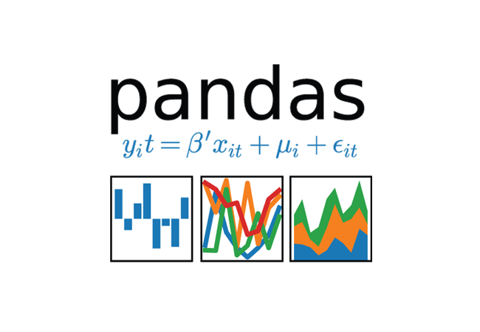
What is pandas?
Pandas is an open-source library in Python for data analysis, data manipulation, and data visualization.
Notes:
pandas is useful for Python users who want to work with data, and searching for a powerful tool for doing so.
We had those concepts before, but panda made it easier to work with data.

Slide 4
More about pandas….
A ton of functionality
Well-supported by the community
Under active development
Lots of documentation
Plays well with other packages
e.g. It is built on top of NumPy (Numerical Python), and works well with scikit-learn

Slide 5
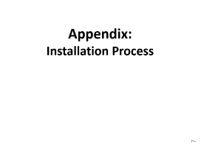

How to get pandas….
The best way is to install Anaconda Distribution, which contains all pandas dependencies….
https://www.anaconda.com/distribution/
You can follow the steps in the

Slide 6

Thank you
Question?
To be
Not to be

Slide 7
Appendix:
Installation Process

Slide 8
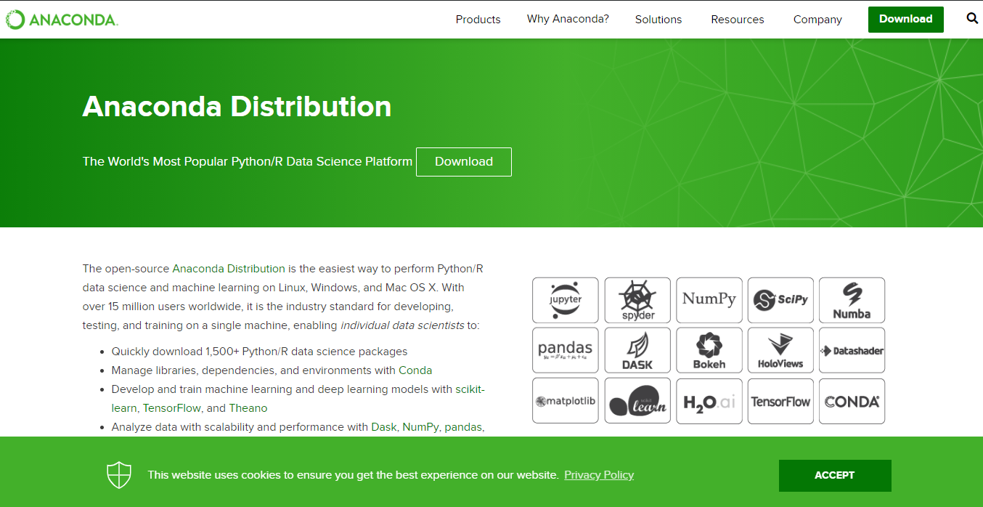
Anaconda Distribution of Python
Notes:
https://www.anaconda.com/distribution/

Slide 9
Anaconda Distribution of Python
2
1

Slide 10
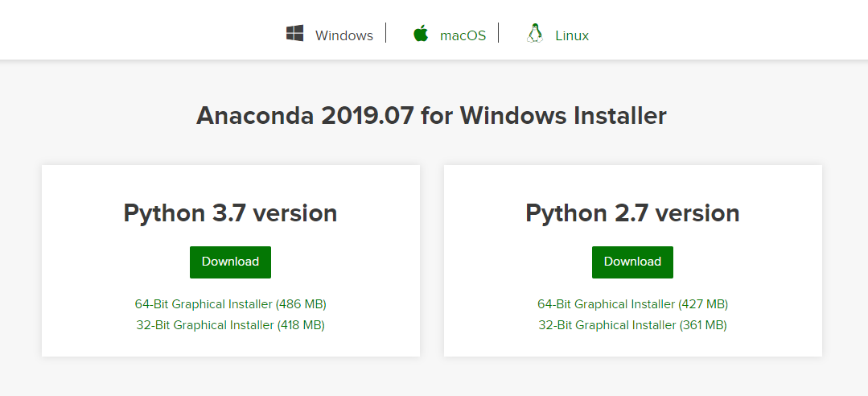
Anaconda Distribution of Python
1
2

Slide 11
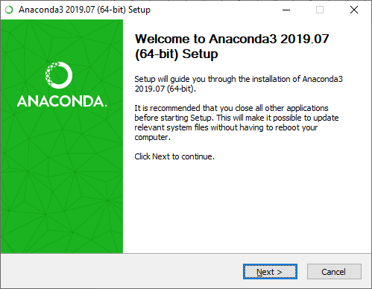
Installation Process
1
2

Slide 12
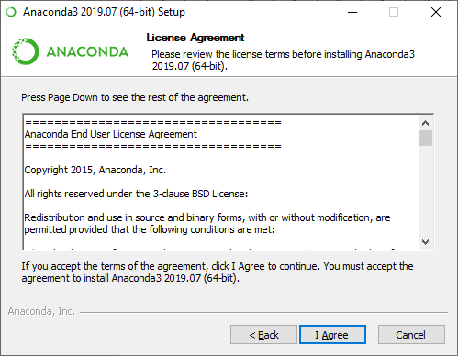
Installation Process

Slide 13
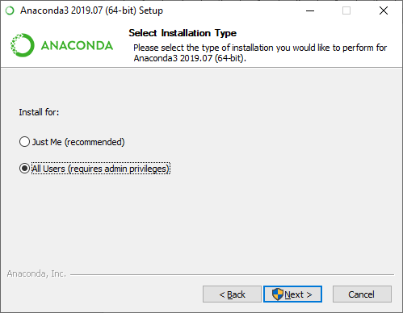
Installation Process
1
2

Slide 14
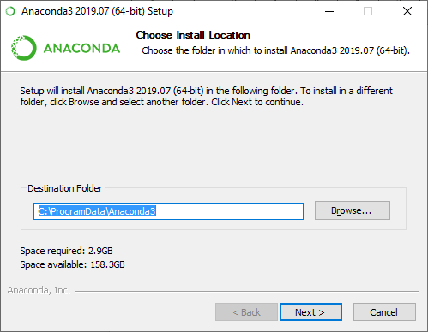
Installation Process
You can change the installation path or leave it as it is.
1
2

Slide 15
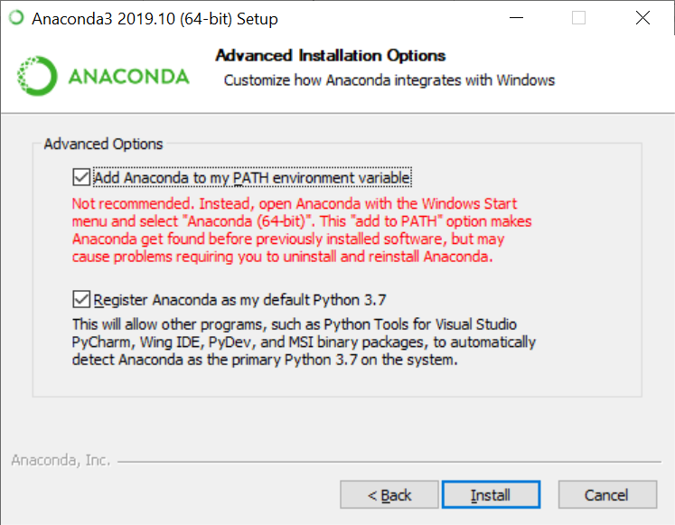
Installation Process

Slide 16
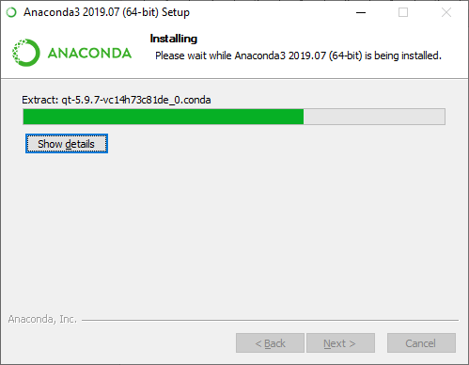
Installation Process

Slide 17
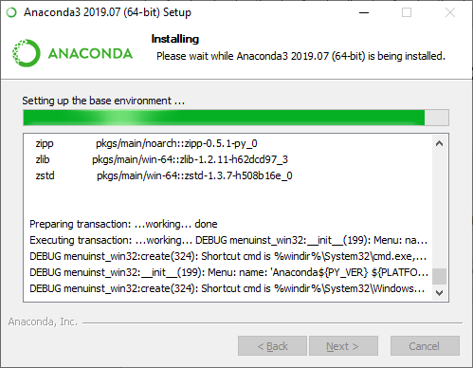
Installation Process

Slide 18
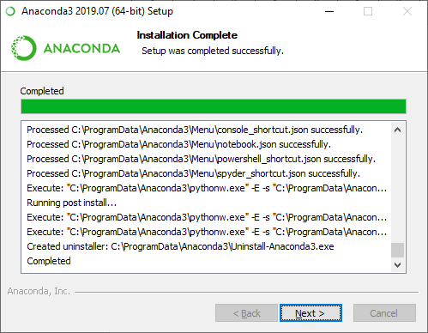
Installation Process

Slide 19
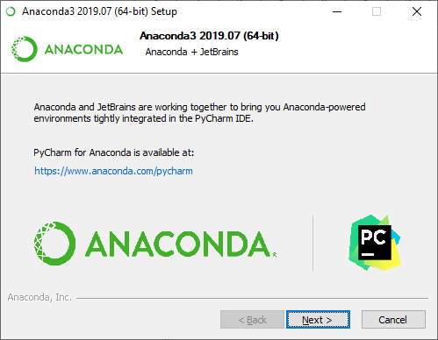
Installation Process

Slide 20
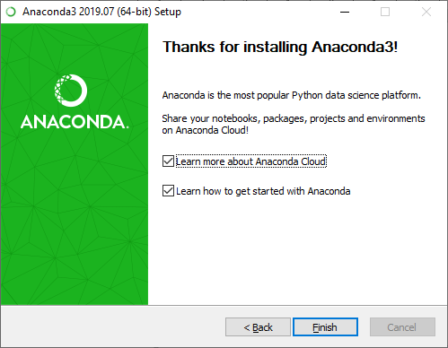
Installation Process

Slide 21
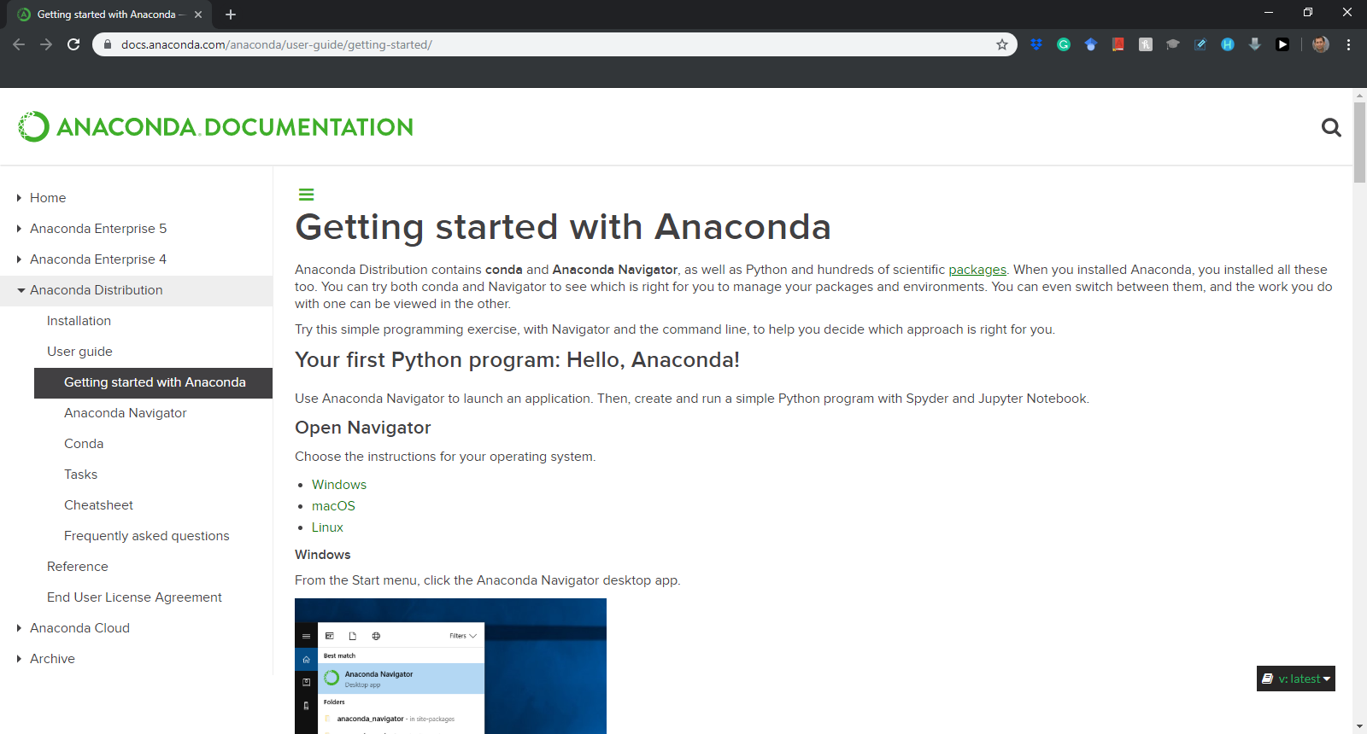
Installation Process
Notes:
https://docs.anaconda.com/anaconda/user-guide/getting-started/

Slide 22
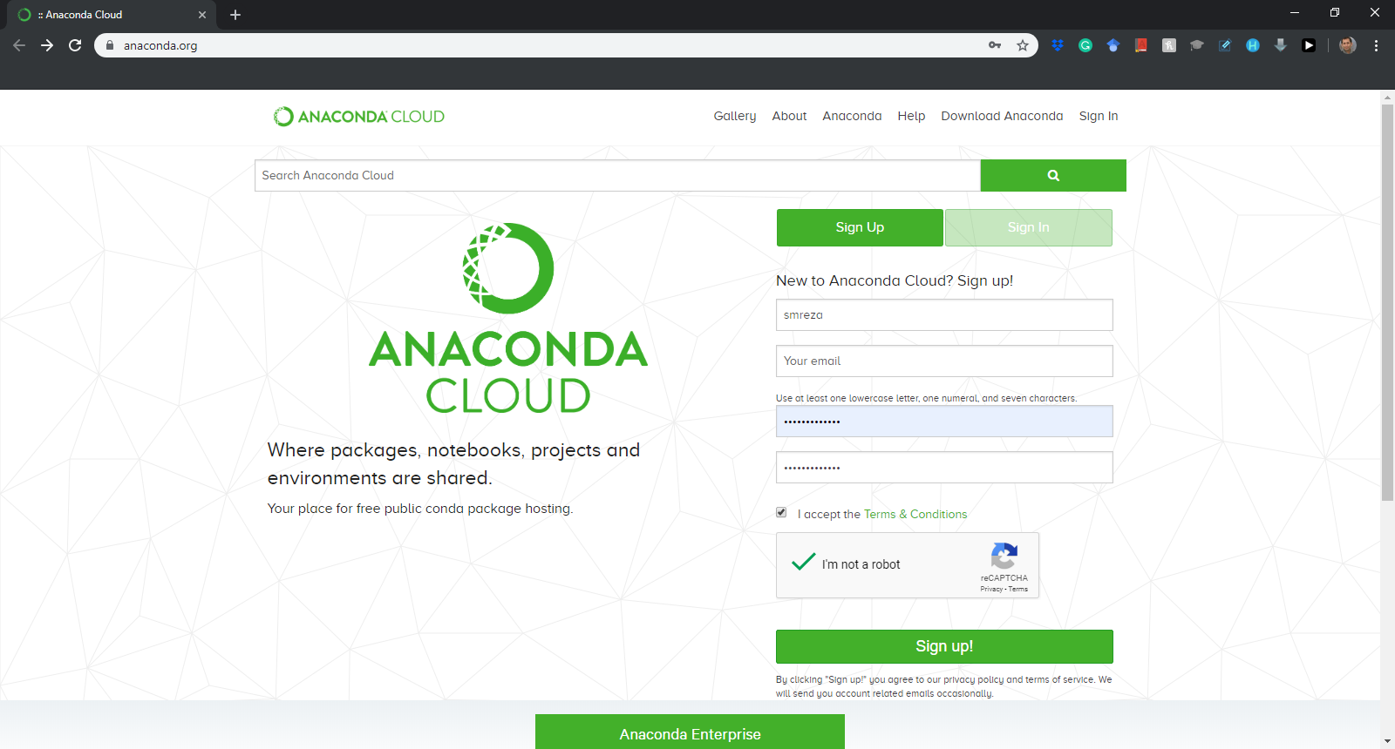
Installation Process
Sign up for the first time….
Notes:
https://anaconda.org/

Slide 23
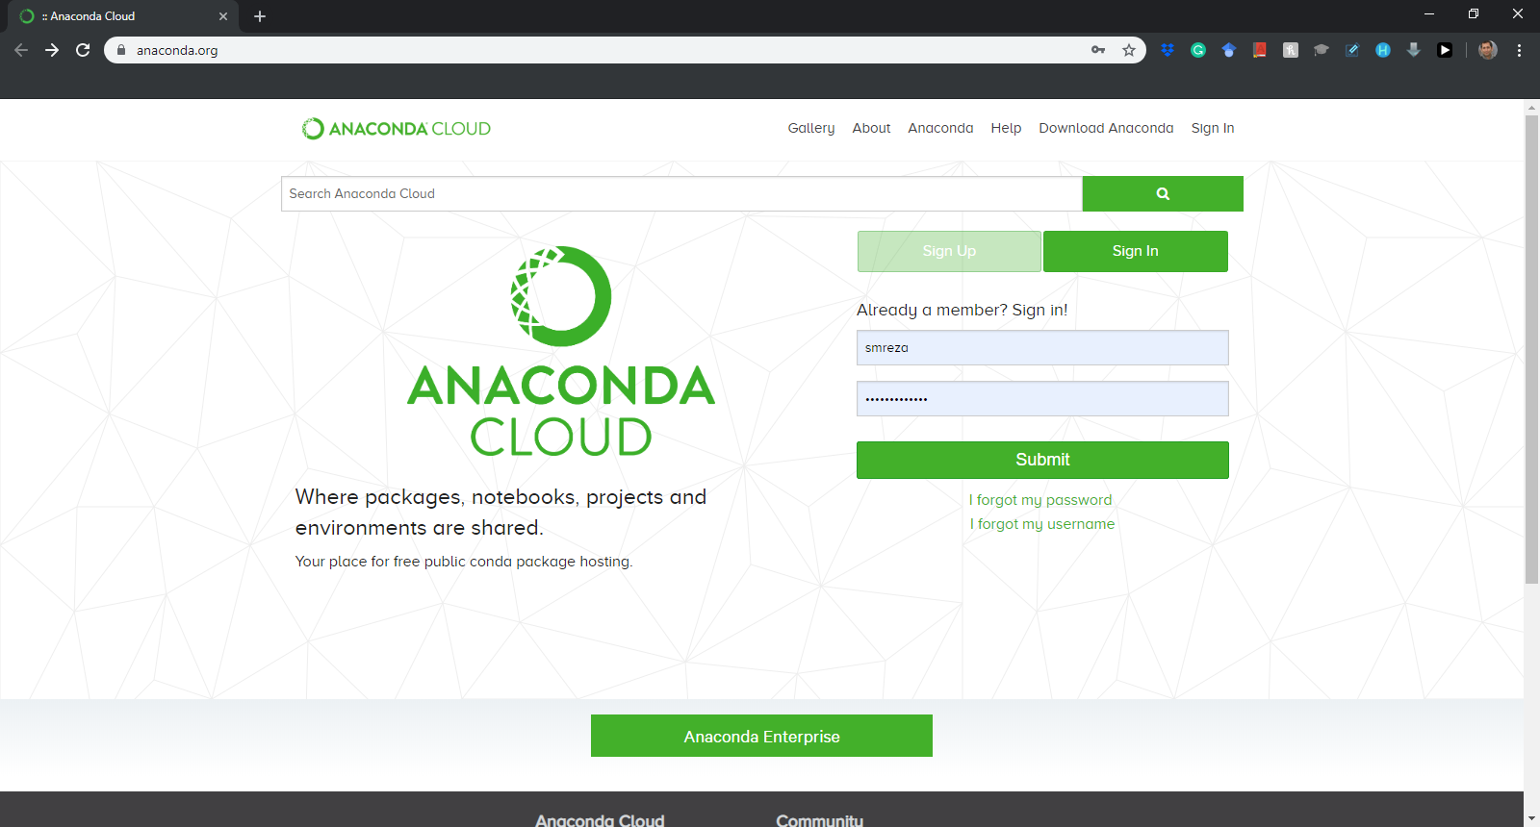
Installation Process
Sign in after the first time….
Notes:
https://anaconda.org/

Slide 24
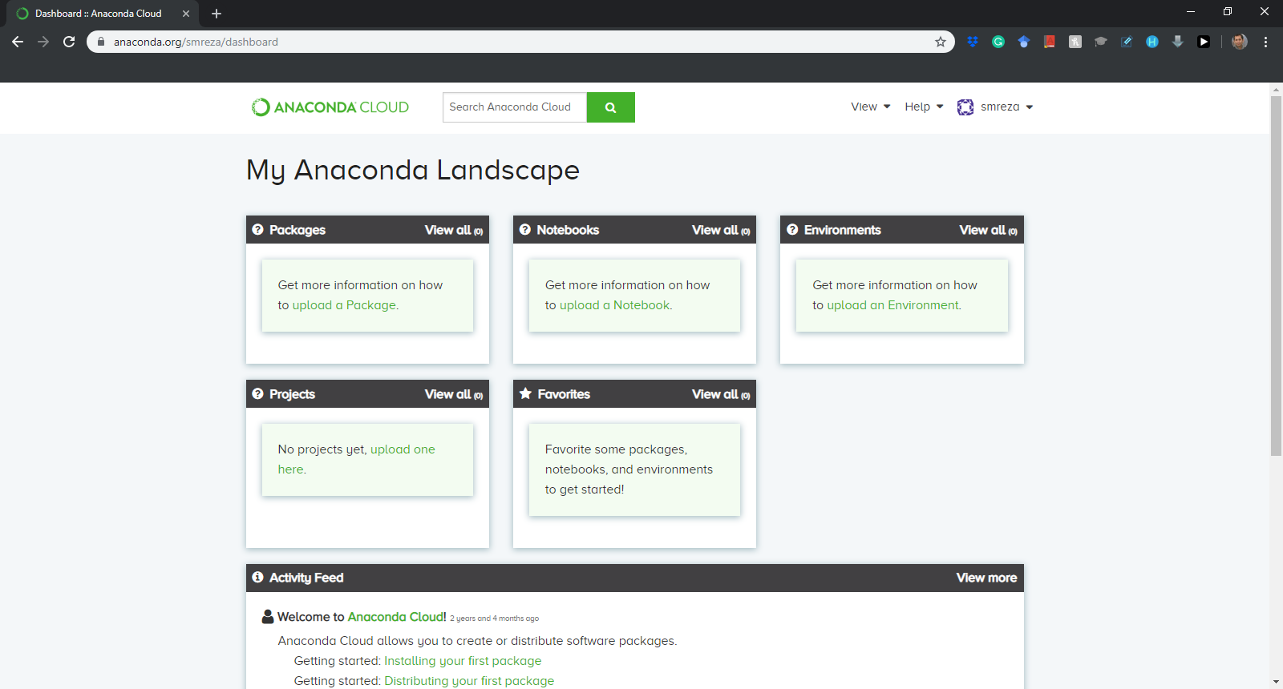
Installation Process

